Slide 1
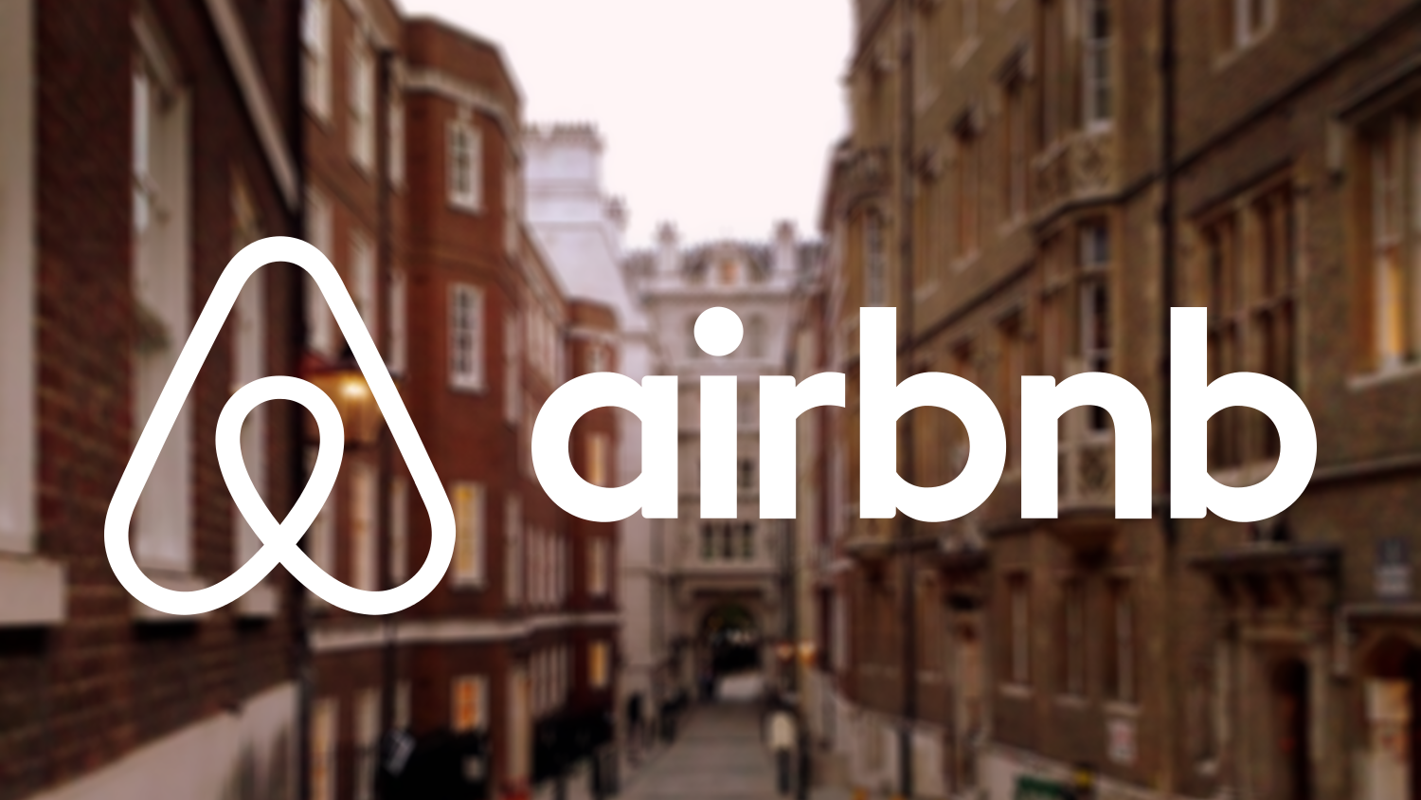
Yi-Yun Su, Hariz Hisham, Erik Chu, Bryan Tamsir

Slide 2
Dataset - New User Bookings Background
In this dataset, we have a list of users along with their demographics, web session records, and some summary statistics. All the users in this dataset are from the USA. Our group will focus on different web analytics questions. There are 12 possible outcomes of the destination country:
‘US’ | ‘PT’
‘FR’ | ‘NL’
‘CA’ | ‘DE’
‘GB’ | ‘AU’
‘ES’ | ‘NDF’ (no destination found)
‘IT’ | ‘Other’

Slide 3
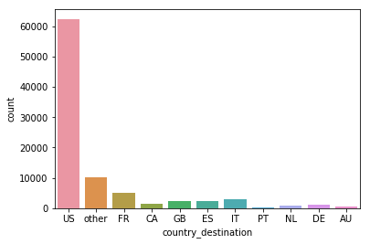
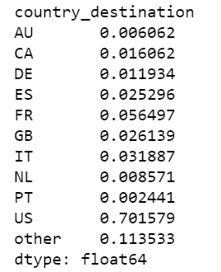
Where do users travel to?
Figure 1.1 - Bar Graph of where users travel to
Most first time users travel within the United States rather than international.

Slide 4
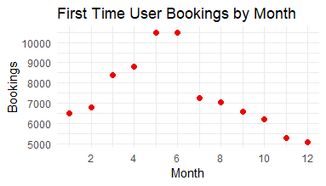
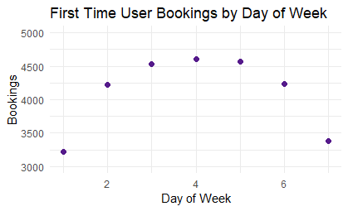
When do users book?
Figure 1.2 - First Time User Bookings by Month
Over the course of the year in the United States, we see a dramatic change in bookings over different months. May, April, and June show an increase in bookings and we suspect it is due to planning for summer vacation. Over the winter months (Nov-Feb), there are noticeable fewer bookings made.
Figure 1.3 - First Time User Bookings by Day
The middle of the week is more popular for first time bookings when compared to the beginning or end of the week, likely to more people being on their computers during the weekday.

Slide 5
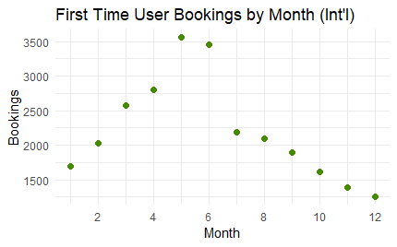
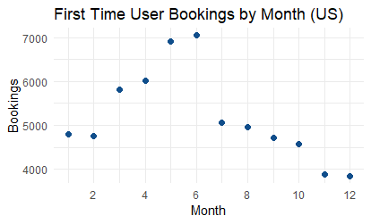
When do users book?
Figure 1.4a & 1.4b - Subset First Time User Bookings by Month
Booking behavior is similar for domestic and international trips across months, with peaks for both trip types peaking in the early summer months.

Slide 6
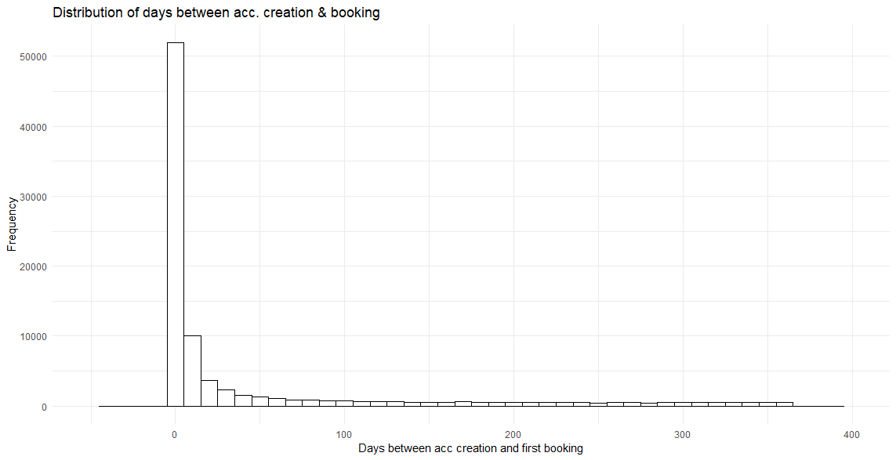
When do users book?
Figure 1.5 - Distribution of Days between account creation and booking
We observe that the majority of bookings happen within a few days, especially on the same day.

Slide 7
Business Questions
What are the sources of conversion for Airbnb first time users?
What kind of methods do new users use for their first bookings?
What is the difference between domestic and international bookings?
Can we identify different needs/preferences using K-Means clustering for domestic or international bookings?

Slide 8

Customer Journey
From signup to booking

Slide 9
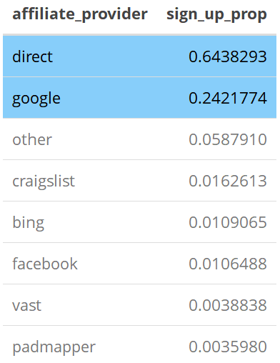
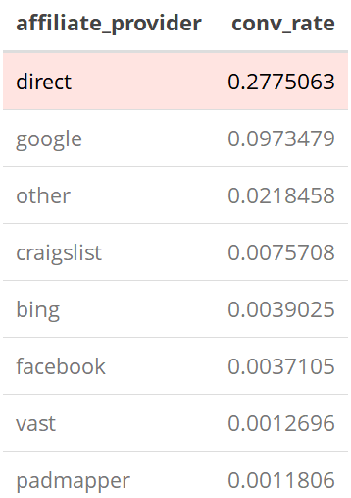
Signups
64% of new users signed up by way of Airbnb direct marketing.
24% through Google Search.
27% of new users who actually booked a trip on Airbnb signed up by way of direct marketing.
Airbnb is doing a great job at marketing directly to its potential customers
Notes:
The two biggest sources are direct and Google.

Slide 10





Conversion Rate
When we look deeper into the top two sources of new user signups (Direct and Google), we find that both channels have similar conversion rates with respect to signups within each channel.
Modified conversion rate equation:

Slide 11
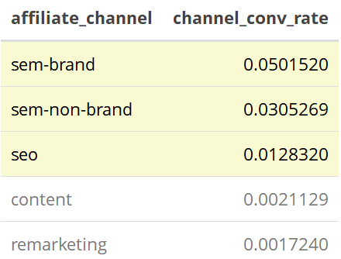
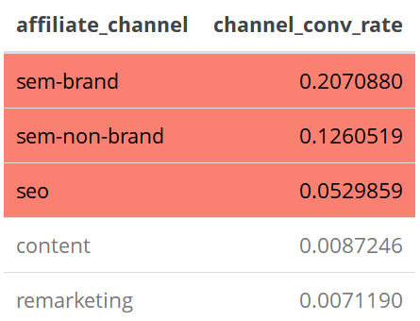
Airbnb and Google Partnership Deep-Dive
What type of marketing techniques does Airbnb do with Google that result in most conversion rates?
Definitions: SEM-Brand: Branded Search Engine Marketing SEM-Non-Brand: Non-branded Search Engine Marketing SEO: Search Engine Optimization
Results:
SEM outperforms SEO in converting new users

Slide 12

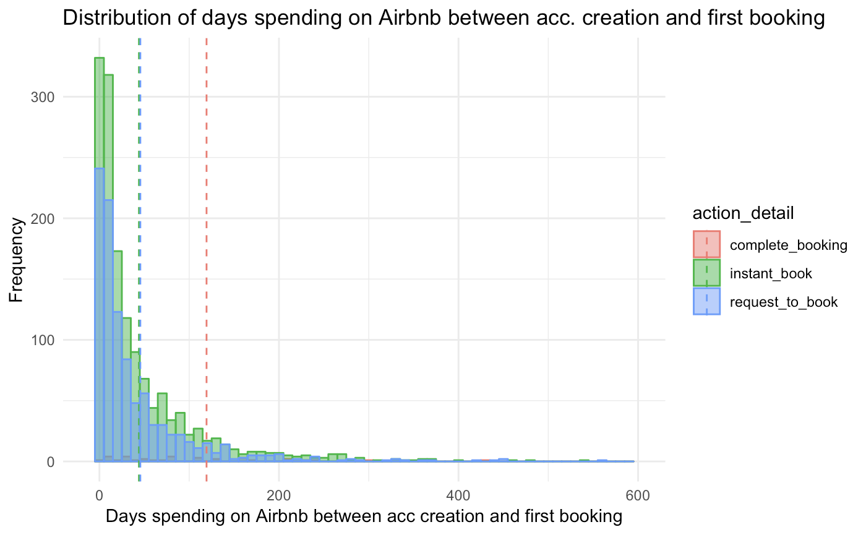

Business Questions
What kind of methods do new user use for their first orders?
“INSTANT BOOKING’’
100% COMPLETION
There are two booking types for new users. But the completion rate is lower and the period is longer for request-booking.
Airbnb should prioritize the instant booking option to new user and simplified the booking process for both the host and new user.
Action | Mean | Number
Instant booking | 44.05756 | 1468
Request booking | 45.57009 | 985
Complete booking | 119.32957 | 36
“REQUEST BOOKING’’
No History Record
No Identity Confirmation
More Complicated Process
2.6%
Notes:
>The cumulative time and amount for both kind of booking shows that the two booking are identically attractive to new users.
>However, the completion rate for the request-booking is only 2.64% and it takes much longer, 119.33 days. The reasons of the these might be the lack of identity certification and review records that the hosts don’t approve the booking, or the complicated booking system that new users are not comfortable with the platform and thereby decided not to book.
In additional, the instant-booking users are more likely to book their next room on Airbnb while most of the request-booking users leave the platform without booking.
> Airbnb should prioritize the instant booking option to new user.
> Airbnb should simplify the booking process.

Slide 13
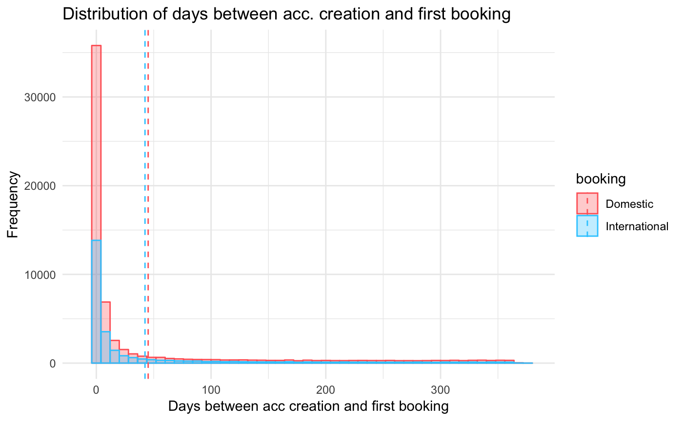


Business Questions
What is the different between domestic and international bookings?
Generally, Airbnb new users in USA are more likely to have domestic booking and thereby Airbnb should promote the domestic trip packages and rooms to new users.
The reaction period is shorter for foreign traveling users. Airbnb should have more frequent follow-up emails to foreign traveling users.
Location | Mean | Amount
Domestic | 45.18876 | 62376
International | 42.41849 | 26532
Notes:
The amount of the foreign booking is ⅓ of the amount of domestic booking but the time period for foreign booking is shorter.

Slide 14

Clustering - International Destinations

Slide 15
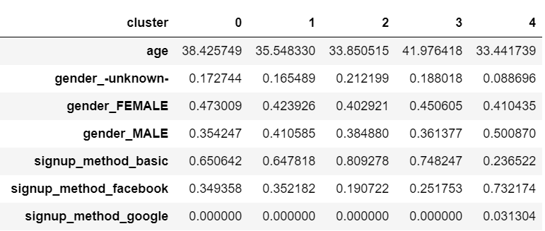
Segment Clusters
Findings
Cluster 4 does not like to use the basic signup and rather signup via Facebook and Google.

Slide 16
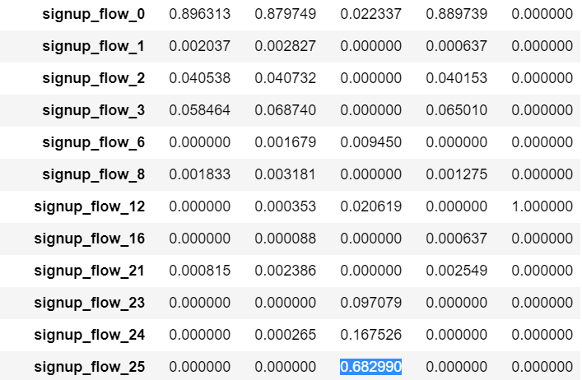
Segment Clusters - Signup Flow
What page do users sign up on?
Findings†
Cluster 2 does not like to sign up immediately but rather on signup page 25.
Cluster 4 is similar but signs up on page 12.
Cluster 2 and 4 are the youngest groups so perhaps they search for rooms prior to signing up.
† Note: sign flow numbers do not signify the n^{th} page the user is on, but instead a specific page an unregistered visitor can view on the Airbnb website

Slide 17
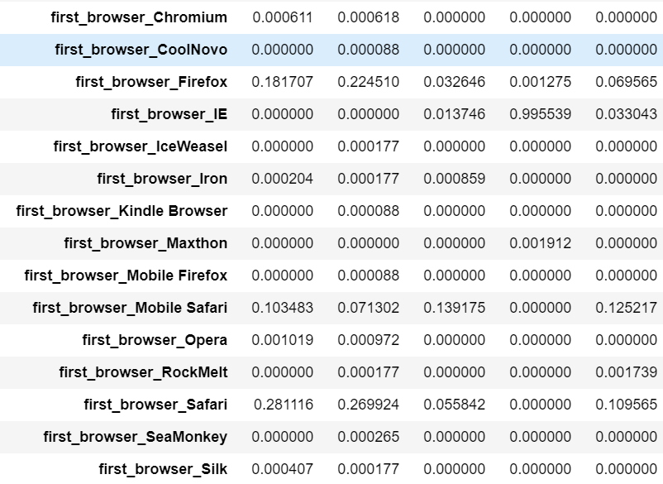
Segment Clusters - Browsers
What browsers do new users use?
Findings
Cluster 3, whom are a bit older, REALLY likes to use Internet Explorer for their browser.

Slide 18
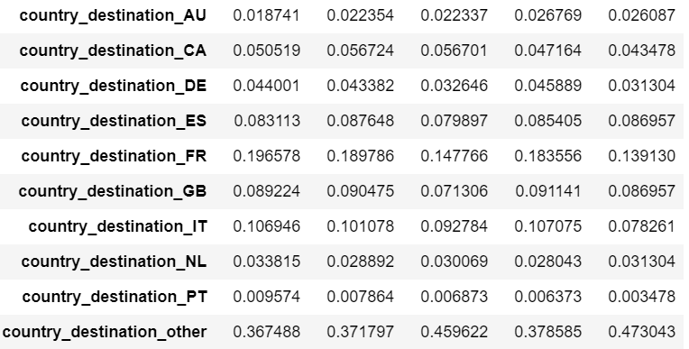
Segment Clusters - Country Destination
What countries are international bookings in?
Findings
Not that much variation across clusters besides France and “other” destinations being popular.

Slide 19

Clustering - Domestic Destinations

Slide 20
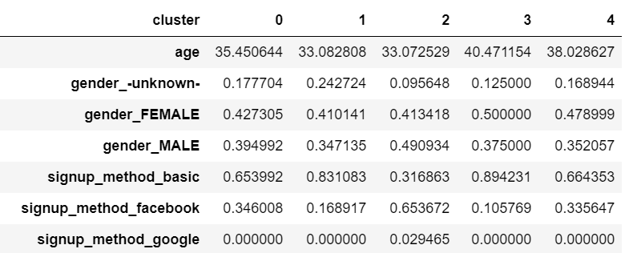
Segment Clusters
Findings
Clusters 1 and 2 are similar ages but prefer different signup methods.

Slide 21
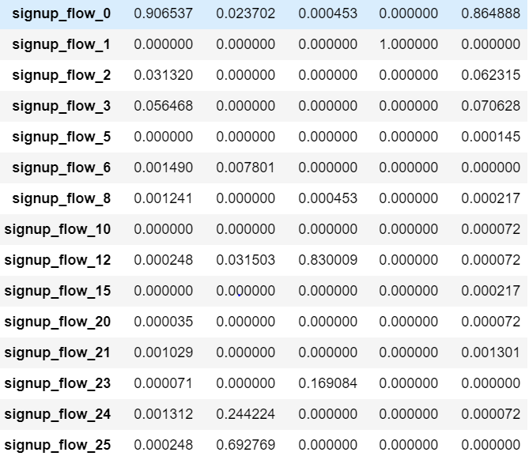
Segment Clusters - Signup Flow
What page do users sign up on?
Findings†
Clusters 0 and 4 usually signup on the first page compared to the others.
Clusters 1, 2, and 3 like signing up on different respective pages.
† Note: sign flow numbers do not signify the n^{th} page the user is on, but instead a specific page an unregistered visitor can view on the Airbnb website

Slide 22
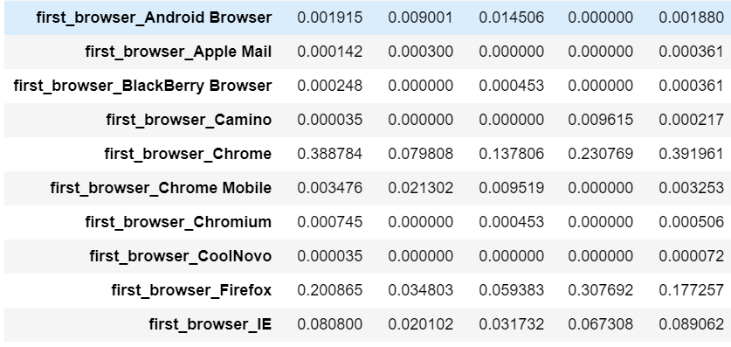
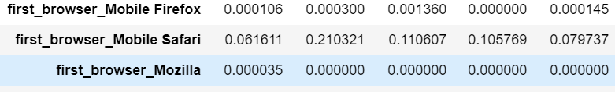
Segment Clusters - Browsers
What browsers do new users use?
Findings
We have decent resolution with browsers such as Chrome and Safari.

Slide 23
Managerial Recommendation
Keep investing in SEM branding
We know it is more effective in converting new users than SEO
Investigate further why SEO is underperforming
Follow up with users making international trips sooner and more frequently
Offer “instant booking” option to new users
Encourages new users to book first trip
May require A/B testing
Airbnb has heterogeneous segments with distinct preferences
Figure out why certain attributes of Airbnb’s platform work better for some segments and improve in that respect
Further investigate domestic destinations at state/city level to really understand segments

Slide 24


